Slide 1


Wise Handover
31 January 2023
+

Slide 2
Business Challenges
Demo Environment
Cloudset Workflow
Document App
Integrations
Assets

Slide 3


Complex processes with a lack of automation across multisystem are leading to work force inefficiency, inhibit agility and reduce customer satisfaction.
Complex case management with numerous tools to reference and copy paste of data which creates inefficiency, possible data loss, duplication of tasks and higher cost to serve.
QA process is lengthy and inefficient and does not allow for agility.
10+ tools required for the majority of longer customer interactions (approx 50% of interactions).
Workflow creation requiring multi-tool interface/ duplicated development to build and maintain. Copy past of data tool to tool means loss of data and reduced quality.
Fully manual workflow with agents spending more time on process with less focus on Customer.
Lack of automation means longer lead times and agent training, quality focus is regulatory and does not give space for excellent CX.
Lengthy quality monitoring process
High rate of attrition meaning longer training times and reduced quality. Risk of Fines increase due to new workforce and inability to effectively control and guide.
Engineering process for workflow changes is lengthy and difficult to replicate and does not allow for expedition of improvements and key changes resulting in lost opportunity, possible additional fines and increased cost to serve.
BUSINESS CHALLENGES
High Costs To Serve
Fragmentation
Too Much Time On process = Less time on CX
Agent Adherence & Productivity
Lack of Agility

Slide 4
Demo Environment
Wise demo account
https://z3n-emea-finance.zendesk.com
Demo Personas:
Customer: Sameera Khan
sameera.secretary@gmail.com
Password: ZenPower1@
2 Agents: Chris (will delete) and Angela
angelaa@5gs0fb.onmicrosoft.com
password: ZenPower1@
2 Primary Custom components:
Flowset Workflow: built by Graham (Cloudset)
Document App built by Wolak (Zendesk)
Notes:
📣 This is Slido interaction slide, please don't delete it.
✅ Click on 'Present with Slido' and the joining instructions will appear when you get to this slide.

Slide 5



To watch a review of this slide go the link below (skip to 13m:26s)
https://zendesk.wistia.com/medias/g8eeg65smy
O P T I M I S E D
G U I D E D W O R K F L O W
streamlined customer journey, enhanced agent experience, full regulatory adherence
Capture / Process Cross-Channel
Automatically Assign, Route & Distribute
Provide visibility to agents & management
Analyse, Design & Iterate - Innovate
Integrate Front and Backoffice
O M N I C H A N N E L
C O N V E R S A T I O N S
seamless integration of communications across channels
</>
E N G A G E M E N T
C E N T R E
embedded digital capability to support innovation & growth
Self-service
Agent
Workspace
AI / ML
SLA Mngt
Single API
Customer Portal
Customer
360
Custom Objects
Knowledge Base
Collaboration
Analytics
Skills
Omni-Channel
Automation
Triggers
Guided Workflow
Encryption
& Redaction
W I S E B A C K O F F I C E
C A P A B I L I T Y
AWS products & developer tools underpin extensive BackOffice capability
AWS API Gateway
REST API
OKTA SSO
Slack Connector
Custom
Apps
ZIS / ZAF Platform
Back-office integration
Ninja
Samurai
Watson
DD Case
Toby
The Ring
Reporting Analytics
Notes:
To watch a review of this slide go the link below (skip to 13m:26s)
https://zendesk.wistia.com/medias/g8eeg65smy

Slide 6
Demo Environment: Approach
To watch the demo overview go the link below (skip to 22m:39s)
https://zendesk.wistia.com/medias/g8eeg65smy
Flowset is a guided workflow engine that works exclusively with Zendesk.
Flowset was used to build a demo workflow process to manage ‘background checks’ for customers who want to open an account in Wise
The demo workflow steps through the following:
Sameera submits initial ‘account open’ request on the Wise Portal (Guide)
The ZD agent reviews submitted documents
  - Rejects submission and requests higher resolution document
Sameera resubmits a higher resolution scan by email or Guide
The agent reviews the higher resolution scan and begins data capture
  - Agent captures employment details and passport details
Capture complete, agent submits for approval to SMA (senior management authority)
SMA approves application
Workflow complete

Slide 7



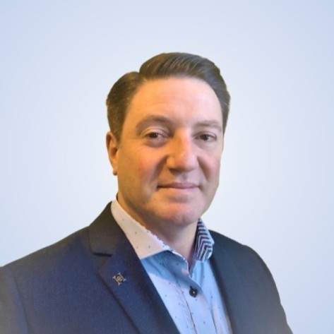

Demo Flow: Wise EDD Flow
Workflow Automation creates assignments
Paulo is an SMA and approves Sameera’s Application
Sameera needs a Wise account for her new business
Christopher owns the case. He checks documents, captures data and escalates where necessary
Sameera submits her ‘new account’ request via the portal
21
Patricia assesses the legal risk & implications
Angela supports Hungarian & ‘Offboarded’ customers
Sameera is satisfied with the result:
She could submit a request easily
She received a quick response
She has full visibility of the process
Sameera searches the Wise Portal for answers
Christopher requests a re-submit of poor quality documents

Slide 8
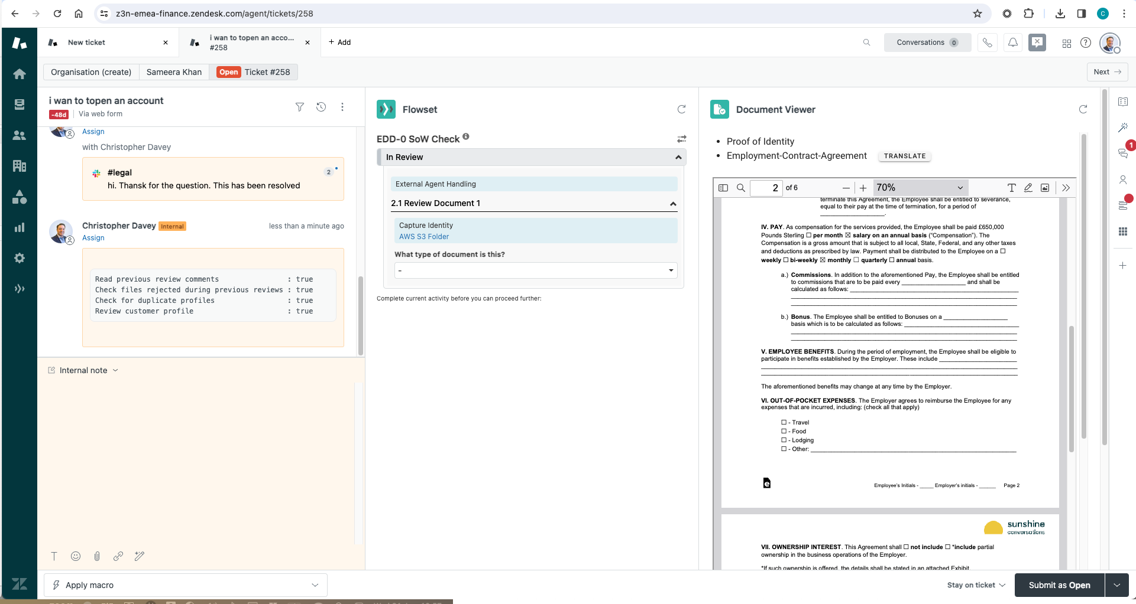
Demo Environment: Flowset Execution
To watch the workflow execution go the link below (skip to 25m:21s)
https://zendesk.wistia.com/medias/g8eeg65smy
We built a 3-pane design to facilitate:
1.) communications & Audit
2.) workflow & data capture
3.) Document Review
Custom Layouts and Contextual workspaces were used to facilitate the 3 pane build and we used rules to load the Layout ONLY when:
Tag = intent__account__new__creating
The Tag was set by Intent detection
Pane 1: Communication and Audit Trail
Pane 2: Workflow and Document Capture
Pane 3: Document Review

Slide 9
Demo Environment: Comms & Audit
This area houses the typical Agent composer and messaging history. It also serves as an automated audit trail of all the data capture and decisions an agent makes.
The majority of the work is performed in the centre and right side of the screen so this area was relegated to the left and reduced in size as it functions an audit trail of all the inputs and decisions an agent takes.
This is

Slide 10
Demo Environment: Workflow & Capture
Graham from Cloudset built the workflow and Capture UI.
The UI is dynamic and uses a workflow builder with conditions and business rules to drive the UI, tasks and questions.
The workflow is driven by the agent’s inputs and responses
For this demo, Graham used a combination of Zendesk fields and Formset fields.
The use case and project will define which is a better fit but is does seem that Flowset fields provide more flexibility and control.
It may be an option to store the data in Custom Objects if they need to be synched down to Wise’ databases by ZIS

Slide 11
Demo Environment: Document App
Wolak built the Demo document App which uses tags (not suggested for production) to define which documents to present in the UI. The tags were set by the Workflow App stages
The features to load documents, zoom, paginate and search etc. were provided through opensource libraries that Wolak found
It is anticipated that for Production we would use either Wise’s current Apps or use similar, publicly available document viewer libraries

Slide 12
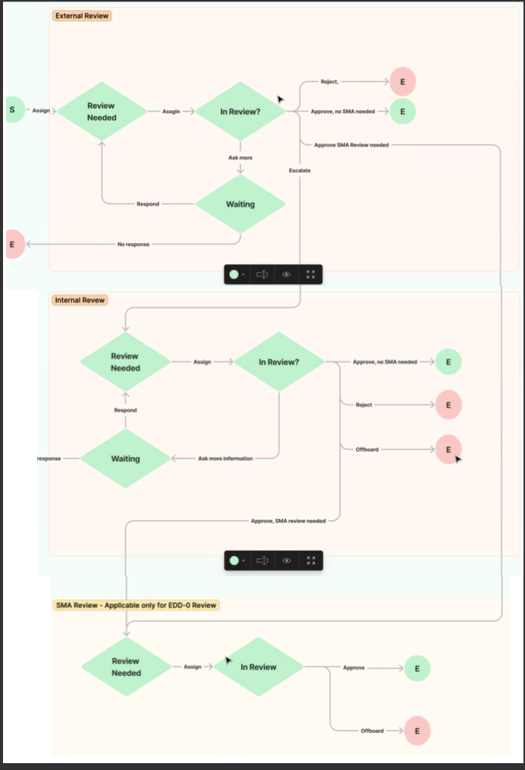
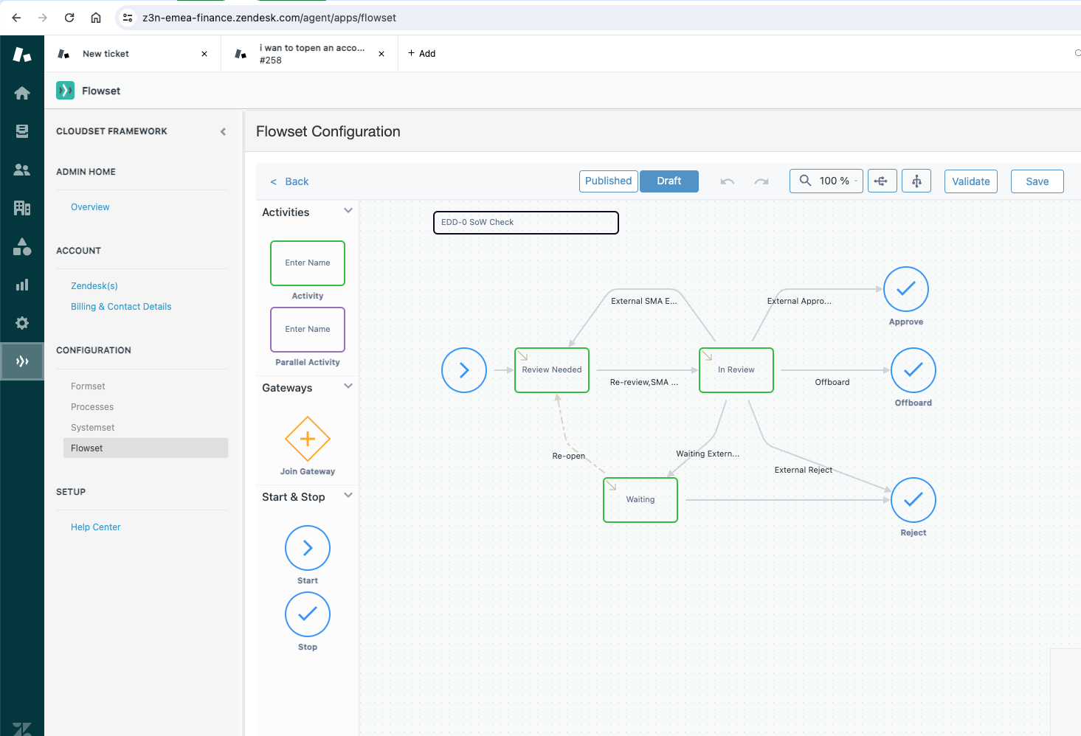
Wise EDD Flow
We re-mapped some of Wise’s EDD workflow to be more reusable
We created:
States: Needs Review, In Review, Waiting
Steps/stages: Document Review, Capture etc.
Outcomes: Rejected, approved, offboarded
Attributes: Internal, External, SMA
Capture Fields: some in Zendesk some in Flowset

Slide 13
Draft
(Input welcome)
Note: The copy-paste only happens with 2b flow, from Workflow the details are auto-generated within Workflow and then at the submission of a decision, saved to Watson Comments as well.
KYC sample agent steps
Show me the generic steps for a ‘typical’ case for a KYC agent…
3a. As necessary, agents view and/or copy/paste the customer details into Watson to have this information to hand (eg. transfers pattern)
4a. Contact the Customer in Zendesk to ask for more information, capturing specific data (eg. spending threshold), close the case etc.
3b. Open the case in Zendesk to see the communications with the Customer
Note: as part of resolution, we also want to capture additional information, e.g. rejection reasons, off-boarding reasons.
1. Open Toby to fetch and assign a case to themselves
2a. Open the case in Workflow to look at the steps needing to be completed
An interaction lands in as a result of manual intervention (KYC) action required, or other escalation
3c. Open Confluence to check knowledge articles
4b. In the case of outsourced reviews, automatically send a recovery email, where rejection reasons determine the specific template for the autorecovery email
2b. OR
Open the case in Ninja to look at the steps needing to be completed, and past interactions (eg. Zendesk tickets)
1a. DDCase working in background to assign case to Agent
Comms channel with the customers can either be from email to email or from email to self-service.
3d. Use Slack to check steps with teammates / team leaders [not always typical; in most cases agents should be able to resolve the case without team or lead input]

Slide 14
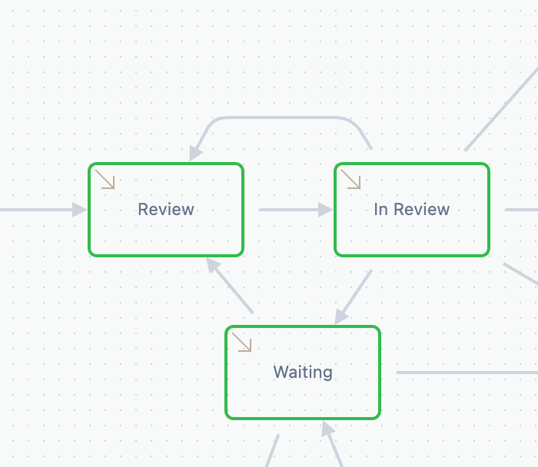
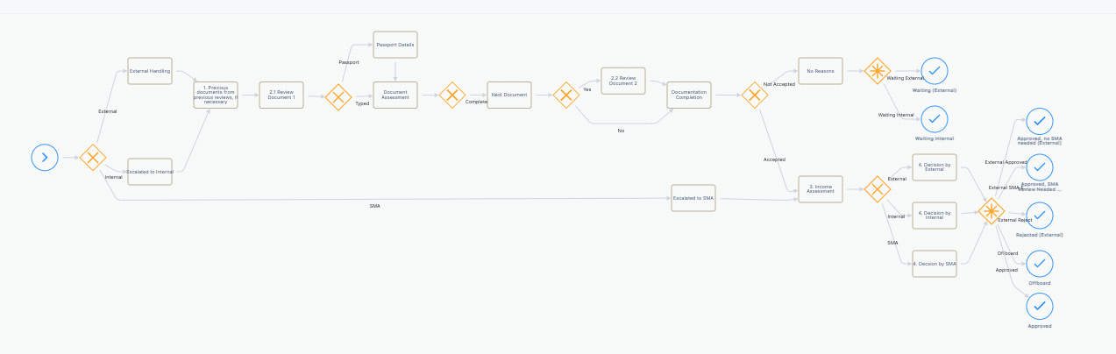
Demo Environment: Workflow Approach
These are the high level container flows built to manage workflow states in Zendesk
Drill Down
High level process
Multiple Processes with sub processes
AND Multiple Document capture processes
- Personal ID (passport etc)
- Business Docs (registration)
- Bank accounts
Sub processes = Document Verification
To watch the build of the workflow go the link below (skip to 1h:28m:40s)
https://zendesk.wistia.com/medias/g8eeg65smy

Slide 15
Zendesk
Audit &
comms
Workflow & Document capture
It may be necessary to use Custom Objects to store interim document capture datapoints for Flowset. This requires extra development from the Cloudset team but is not seen as an significant undertaking
Document
Viewer
Customer ID | Customer name | Doc ID (Key) | Filed x
123456 | Blob The Builder | 654321 | Review
Custom Objects
Integration BUS / API
Doc ID | Doc Name | Location | Passport No
987654 | Passport.jpg | Blob 1029384756 | 456789
987654 | Passport.jpg | S3\folder z | 456789
Wise stores and accesses documents from AWS S3 Buckets currently.
AWS\S3\folder z\customer 123456

Slide 16
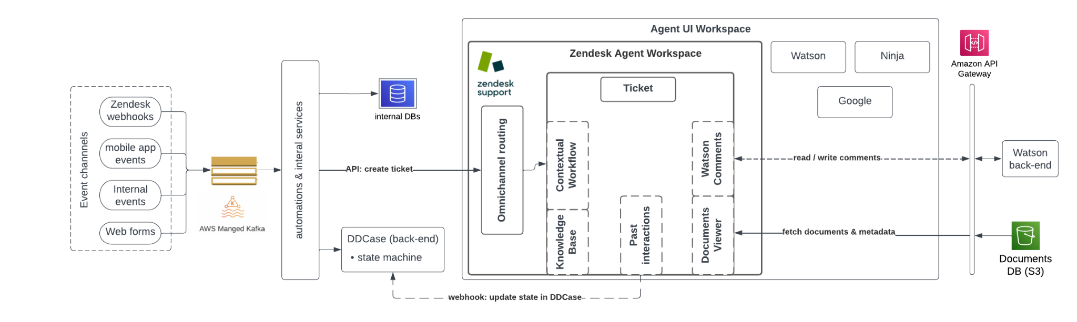
Integrations
From the demo perspective there was no integration delivered.
From a production standpoint there will be a lot of integration required. Although Wise have built a number of integrations between back office and front office services, there is no common / published API or Enterprise Service Bus. Wise struggle with integration and are performing custom integration for each project.
Please connect with Wolak to review integration options

Slide 17
Wise CX Tooling: current state
Draft
(Input welcome)
Back end
Front end (agent)
Customer data store(s)
Transaction data store(s)
DDCase
Case management state machine
Routing engine
Toby
Front-facing view of DDCase.
Agents click to ‘fetch’ & ‘assign’ cases to themselves
Workflow
Task execution tool for agents
Watson
Consolidated view of customer data
Mainly read-only for agents to view (not take action)
Ninja
Master system of customer record for Customer Services.
Links out to other tools (eg. Twilio)
The Ring (built on Twilio)
Front-facing system to manage contacts
Channels:
Voice (~20%)
Email (~80%)
(Chat turned off currently)
KYC
PO
FC
KYC
PO
FC
CS
KYC
PO
FC
CS
KYC
FC
CS
Samurai
Single action workflows / task execution system
Confluence
Internal knowledge repository
Slack
Internal comms tool
Zendesk
Email tool for inbound and outbound customer contact
Key: Core teams
FC
Financial Crime
PO
KYC
PO
FC
CS
KYC
PO
FC
CS
KYC
FC
PO
CS
Customer Support
KYC
T/L tools:
Klaus (Quality), Calabrio, Lookr, Reporting tool (Superset, Lookr)
Know Your Customer
PO
Payment Operations

Slide 18
Solution Notes
Documents
Amazon OCR to read document
Amazon Translate to conduct document translation
A tool to scroll through the document & capture / summarise details
Workflow
Cloudset
Visual UI that tells agent what to do next
Agent has to register their decision
Escalation, Routing, Assignment all handled by workflow
Escalations into Slack
Either we show Guide for iKB, or we can show that the instructions are built into workflow based on what is in confluence
Calculations
Not provided by FlowSet
Need to build capability
Capture screens
Build capture screens and logic in Zendesk
Demonstrate document capture and validation can be separated so that agents can do this in a repetitive manner in parallel to other activities on the case
Audit
All the notes are captured within the case for audit purposes
  Integration with Watson notes - read / summarise / present them in Zendesk for agent to refer to
Open topics:
Document management & access to sensitive documents
Calculations capability
Integrations
DDCase
Toby
Watson comments
Ninja (phase 2?)
Watson (phase 2?)

Slide 19
Assets
Wise discussion: Moving off Zendesk – 15/11/22
https://zendesk.wistia.com/medias/61q1m4h2vr
Wise Discovery session 1: BRC (Business Refresh Cycle) – 20/11/23
https://zendesk.wistia.com/medias/szoqmvt8z3
BRC Process Map
https://www.figma.com/file/IDq1L9OfkxH1Y9fOJelsA4/Processes?type=whiteboard&node-id=0-1&t=cljgsqMHlyzWEzaT-0
Wise Discovery session 2: EDD Onboarding Overview - 30/11/23
https://zendesk.wistia.com/medias/5gqy5jrouc
Wise workshop notes: Nov ‘22
https://docs.google.com/document/d/1rSECpMEboEWLVVU2l-gMq35wCEjmKMv0TGh2dPIS6KE/edit#heading=h.dm36h9vuggq6
Wise Value Discovery Notes:
https://docs.google.com/document/d/1xn2hun-Ha3pMiEJ30sSxu_TaLdWDTTyHJQl4WasAYZo/edit#heading=h.rwpxgfl6rue0
Wise Presentation - 14/12/23
https://docs.google.com/presentation/d/1R43PJLS9hkE2CcsRs7XS_8DxCfsodQsnAmvFrBLdswg/edit?usp=sharing
Wise Presentation and Demo - 14/12/23
https://zendesk.wistia.com/medias/g8eeg65smy
Wise Tooling
https://docs.google.com/presentation/d/19HTTZ3El5bJzIA7wOjQB8z20Qh7haP-U2w_NAn92kv8/edit#slide=id.g2a374a8bb01_0_262

Slide 20

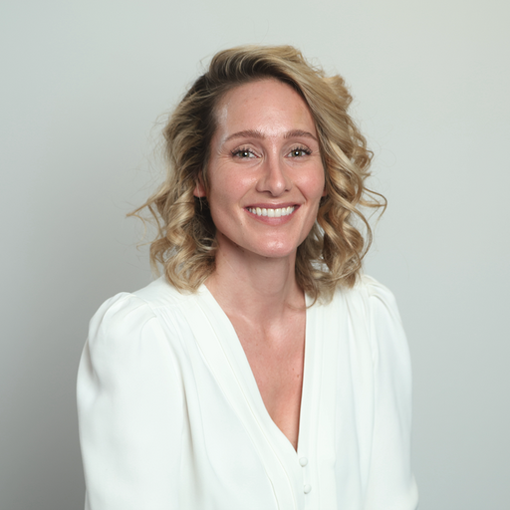
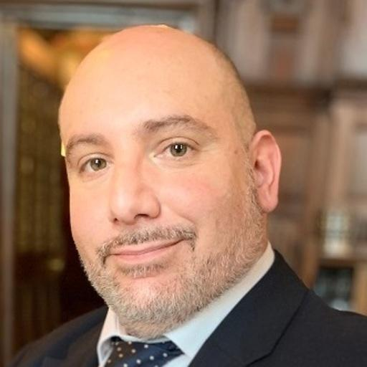

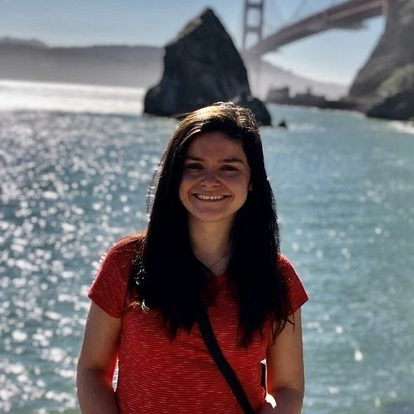
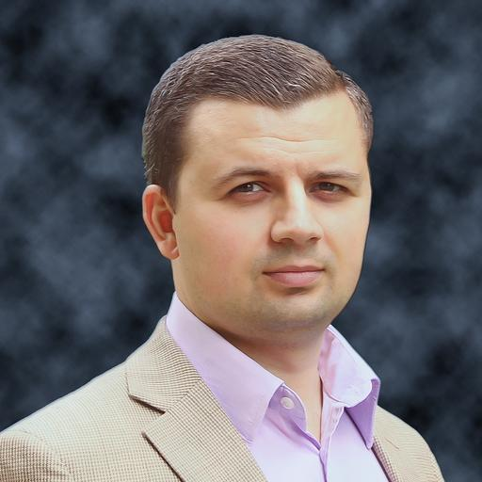

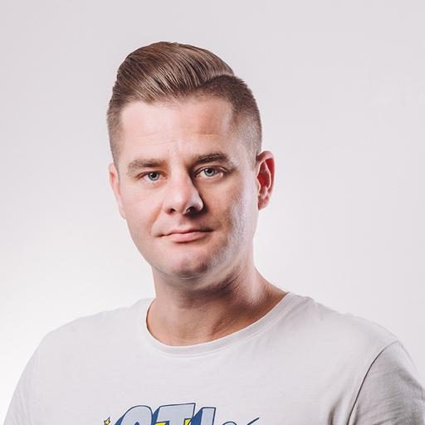
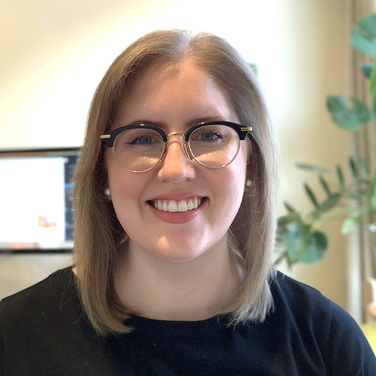
The Zendesk team
Account Executive
CX Strategist
Joshua Green
Emily Freeland
Customer Success Manager
Transformation Solution Consultant
Peter Eshkeri
Christopher Davey
Solution Consultant
Transformation Engagement Lead
Laura Daly
Sergiu Birca
Workflow Specialist
Transformation Technical Architect
Graham Robson
Pawel Wolak
Transformation Program Manager
Charlotte Weaver

